Slide 1

ECOSCAN
Plant Disease Detection System

Slide 2
AGENDA
01.
02.
03.
04.
05.
06.
10.
Improvements
Project Description & Problem Statement
Team Agreement & Personas
Burn down Chart & Retrospective
11.
MVP And Tools Used
Machine Learning Algorithm
Diagrams
Code Snippet and Demo
07.
08.
09.
12.
Sprint Recap & Project backlog
User Stories & Acceptance Criteria
Test Cases & Sprint backlog
Technical Paper

Slide 3

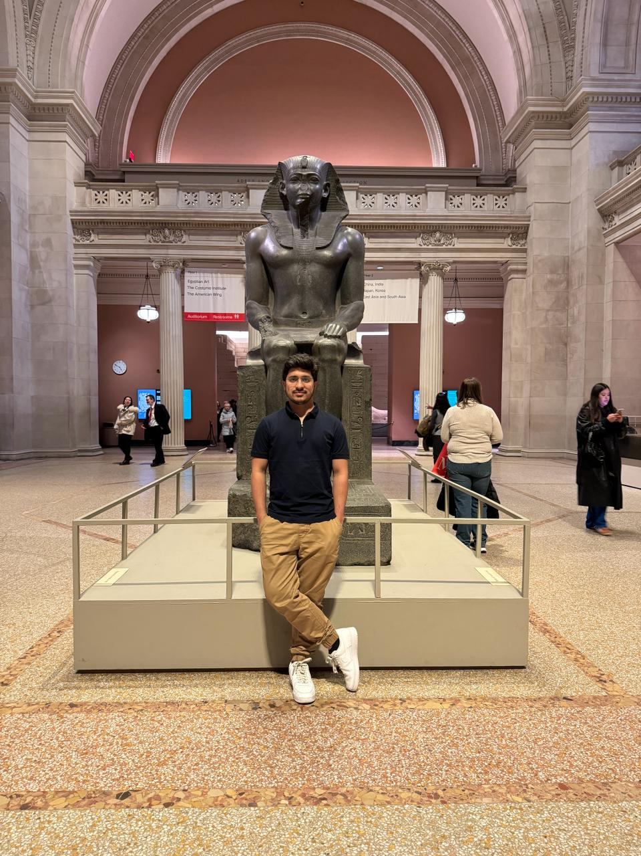

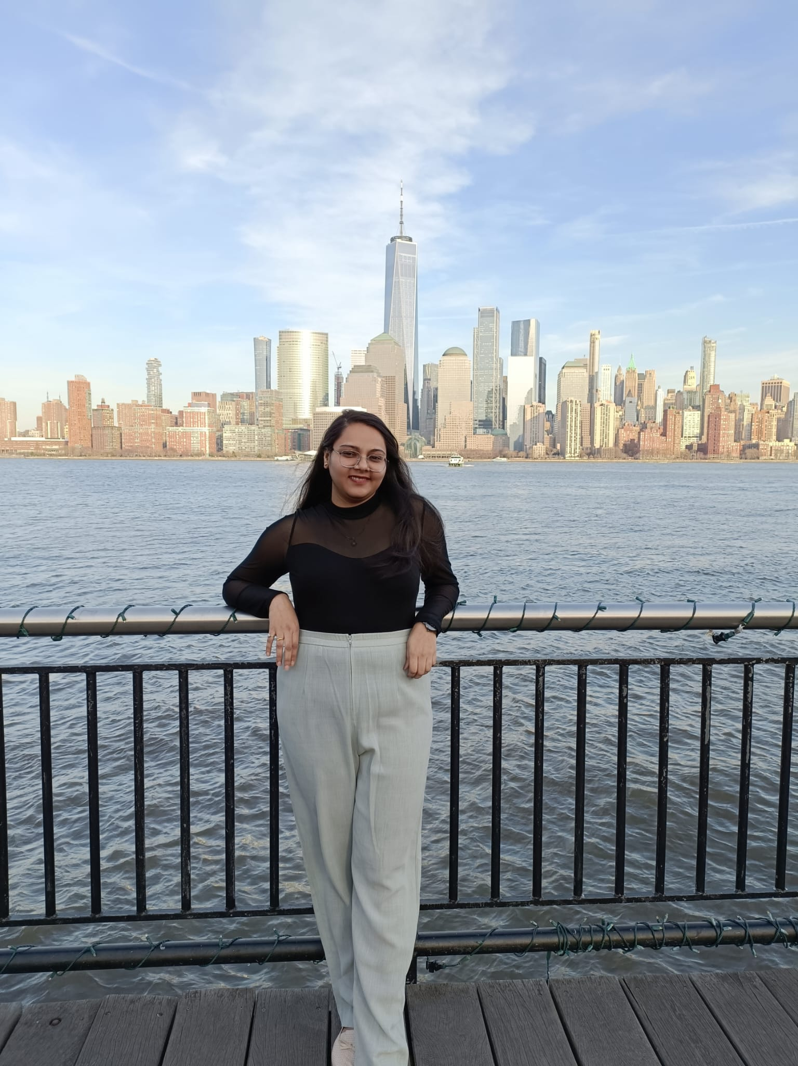

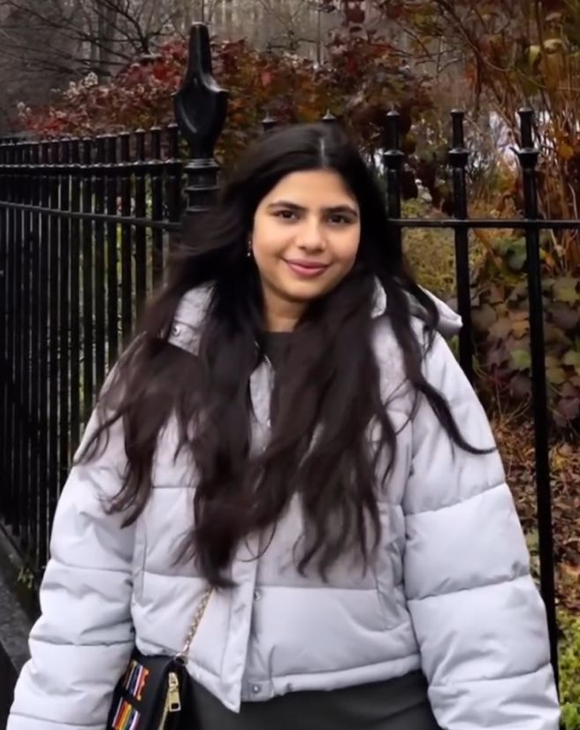
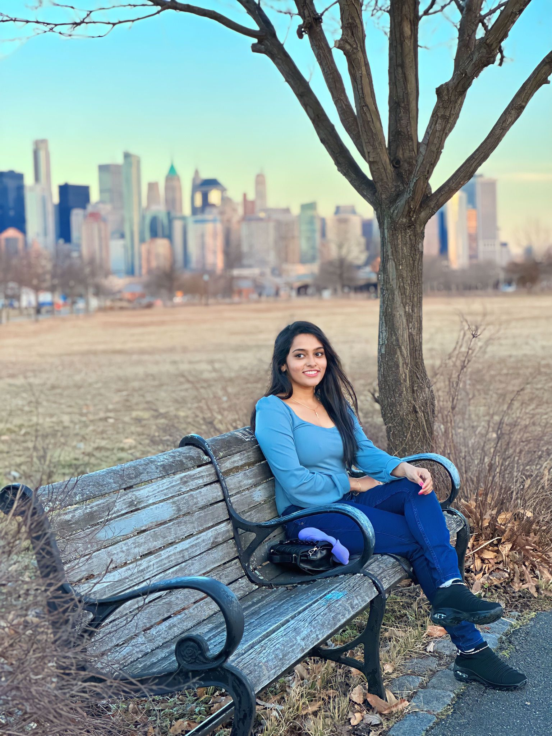
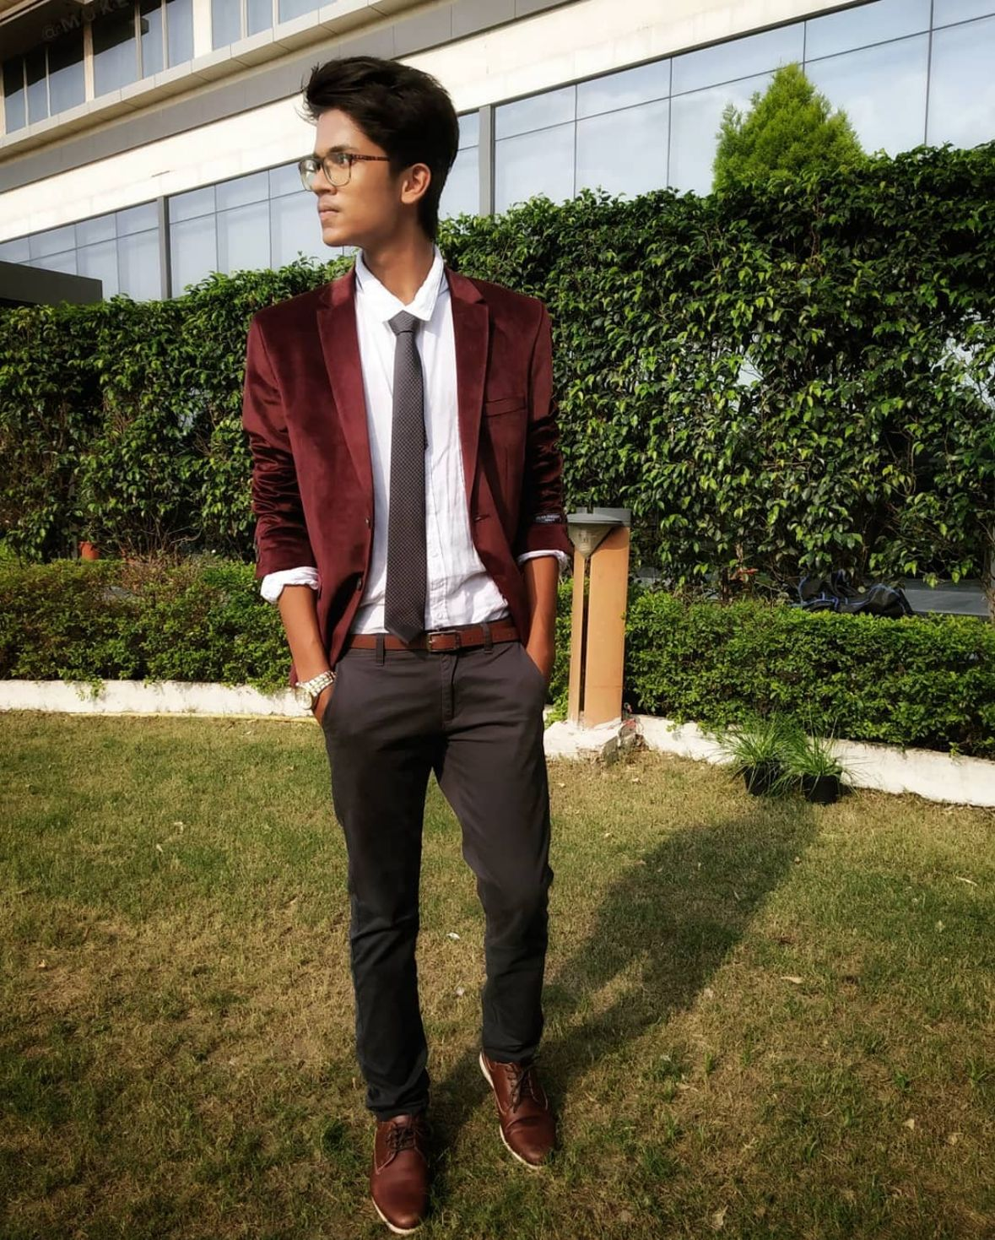
Our Team
Rudra Chobe
Scrum Master
Omkar Gurav
Developer
Shriya Haral
Developer
Ritika Chougala
Developer
Lokeshwar Anchuri
Developer
Niyati Ghagada
Developer
Uma Maheswari Addala
Developer /Tester
Mukesh Suddala
Developer/Quality Assurance

Slide 4
IMPROVEMENTS MADE FROM PROFESSOR’S FEEBACK
Added acceptance criteria and user stories in the same slides
Added Project Description as per the template
Made changes to test cases
Added Team velocity chart
Included demo in the Presentation
This indicates the changes made

Slide 5

PROBLEM WHICH WE ARE ADDRESSING

Slide 6
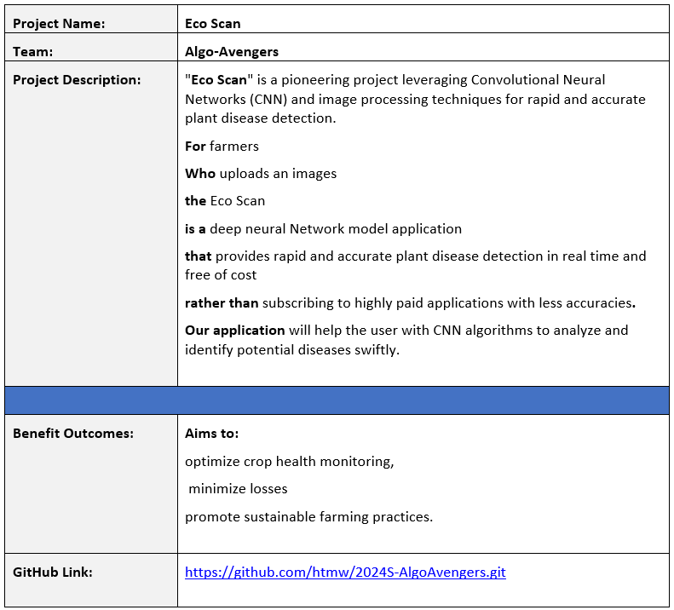
Project Description

Slide 7
Problem Statement
Furthermore, the economic impact of plant diseases on farmers and the agriculture industry is substantial, with losses stemming from reduced yields, increased use of pesticides, and the potential spread of diseases to neighboring crops. In the face of climate change and global trade, the dynamics of plant diseases are evolving, necessitating a more adaptive and technology-driven approach to diagnosis and management. The development of efficient and scalable plant disease detection solutions that leverage advancements in artificial intelligence, machine learning, and image processing is paramount. By addressing these challenges, we can empower farmers with timely information, minimize crop losses, promote sustainable farming practices, and contribute to the overall resilience of the agricultural sector in the face of emerging plant health threats

Slide 8
Problem Statement
The agriculture sector plays a crucial role in sustaining global food security, and plant diseases pose a significant threat to crop yield and quality. Identifying and managing these diseases in a timely and accurate manner is essential for ensuring food production. However, the current methods of plant disease detection often rely on visual inspection by experts, leading to delays in diagnosis and sometimes inaccurate assessments. Additionally, the increasing complexity and variability of plant diseases make it challenging for traditional methods to keep pace with emerging threats. There is a pressing need for advanced and automated plant disease detection systems that can provide rapid, reliable, and precise identification of diseases, enabling farmers to take proactive measures to protect their crops and enhance overall agricultural productivity.

Slide 9
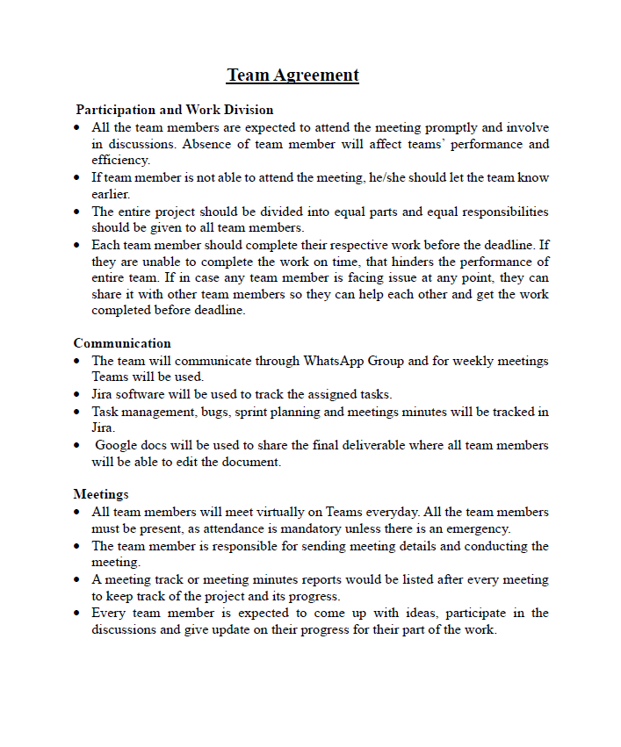
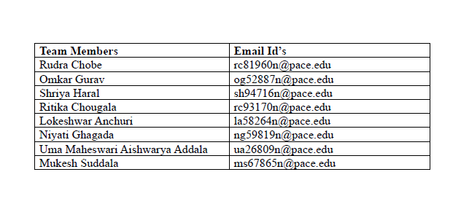
TEAM AGREMENT

Slide 10
PERSONAS

Slide 11
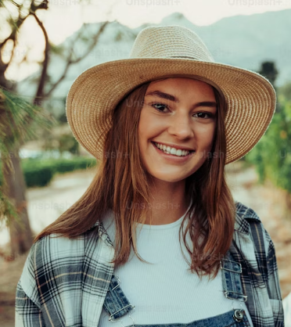
PERSONAS
Ava, the progressive farmer is deep-rooted in the rhythm of the seasons, guiding her farm through cycles of growth and harvest. Yet, she's no stranger to the harsh realities of plant disease and its impact on yield and sustainability. Faced with the complexities of organic farming, she's seeking innovative solutions to protect her crops without resorting to chemical interventions.
Interests
Aside from her passion for sustainable farming, Ava is interested in the latest agricultural technologies that can help optimize organic farming practices.
Frustration
The unpredictability of plant diseases and the limited effectiveness of conventional organic methods in rapid detection and management are her main obstacles.
Goals
Ava is determined to integrate cutting-edge technology into her farming practices to boost productivity while adhering to organic principles.
Name: Ava
Age: 28
Location: Ames, Iowa
Occupation: Owner and
operator of an organic farm
Income: $66,000/annually
Family: Married

Slide 12

PERSONAS
Raj is a visionary in his field, constantly coding and testing the limits of artificial intelligence to serve the earth's farmers. He sees the potential in every line of code to revolutionize traditional farming practices. However, he struggles to find real-world test beds for his algorithms, which are necessary to refine and tailor his solutions to the nuanced needs of agriculture.
Interests
Participating in Hackathons, Coding contests etc.
Practicing yoga and mindfulness
Emerging tech in AI.
Frustration
Access to diverse agricultural data and the hesitancy of the farming community to adopt new technologies are his primary challenges.
Goals
To develop a robust platform that can adapt to various agricultural contexts and improve farm resilience against diseases.
Name: Raj
Age: 30
Location: New York City, NY
Occupation: AI Software
Engineer in Agri-Tech
Income: $120,000/annually
Family: Single

Slide 13
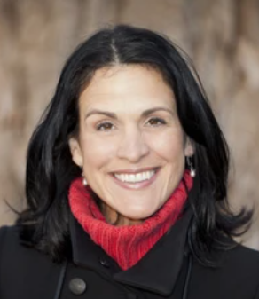
PERSONAS
Claire is a bridge between the agrarian world and the halls of legislation, tirelessly working to shape policies that promote ecological stewardship and technological innovation in farming. She understands the urgency of sustainable agriculture in the face of climate change but is often met with resistance from policymakers reluctant to prioritize or fund these initiatives.
Interests
Enjoys reading about global economic trends.
Organizes educational workshops on sustainability.
Enjoying weekend family outings
Frustration
Her challenge is to navigate the complex political and economic landscapes to secure support and funding for agricultural technology initiatives
Goals
To influence the adoption of sustainable agriculture policies that support and encourage the use of advanced technologies like "Eco Scan."
Name: Claire
Age: 52
Location: Brussels, Belgium
Occupation: Environment Policy Advisor
Income: $70,000/annually
Family: Married

Slide 14
MINIMAL VIABLE PRODUCT

Slide 15
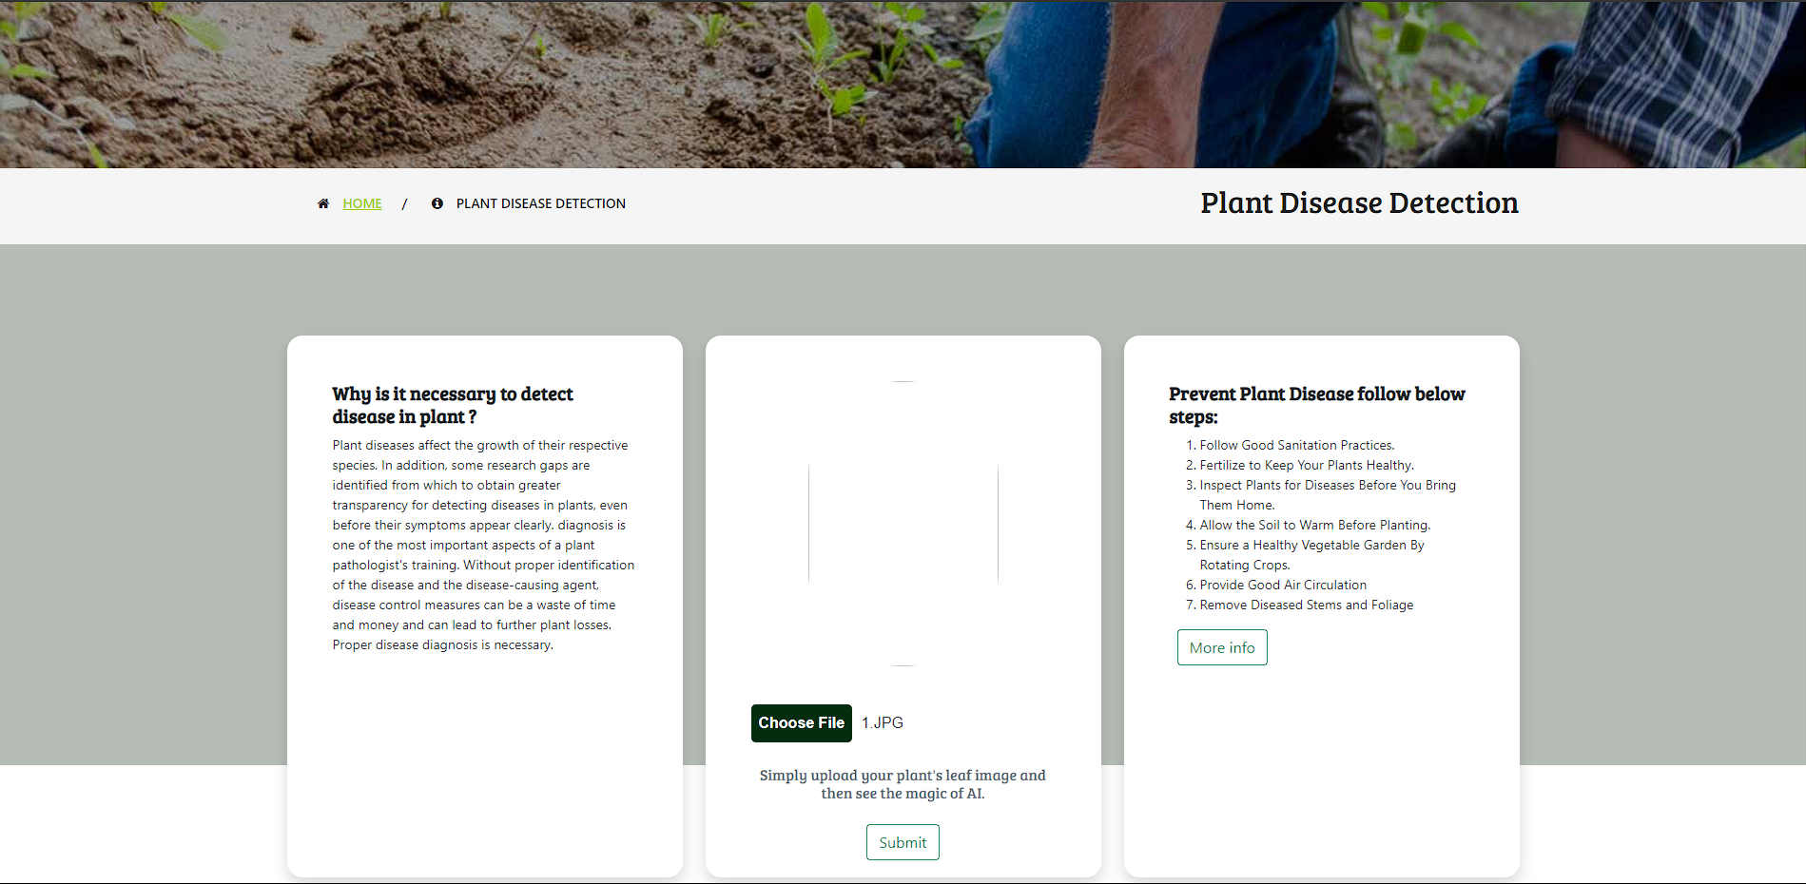
MVP
DISEASE DETECTION PAGE
- A user-friendly interface allowing users to upload images of plant leaves for disease detection, promoting ease of use and accessibility.
- Presentation of detected disease name, stage, description, precautions, and recommended supplements based on the uploaded image.
- An informative section explaining the importance of detecting diseases in plants. This could include preventing crop loss, maintaining agricultural productivity, and ensuring overall plant health.
- Clear and concise steps outlined to prevent plant diseases. This may include practices such as regular inspection, timely treatment, and maintaining optimal growing conditions.
- Know Why is it necessary to detect disease in plant ?
- Check Prevent Plant Disease steps.

Slide 16
TOOLS AND WHERE THEY ARE USED

Slide 17










TOOLS AND LANGUAGES
Python
Numpy
OpenCV
Keras
CSS
JIRA
TensorFlow
HTML
Visual Studio
GIT

Slide 18



WHERE ARE THEY USED?
Front End
HTML, CSS: Used for building our website
Visual Studio: For Front end coding
Figma: Used for Designing (Design Interface)
Back End
Keras, Numpy , Tensorflow: ML Libraries used for model building
Python: Used for programming ML Models
Open CV: For object detection
Django : To connect with Front end
Management
JIRA : Planning and workflow
Teams : Daily meetings
WhatsApp : Daily communications
Git : For Source code management

Slide 19
Machine Learning Algorithm

Slide 20
MACHINE LEARNING ALGORITHM
Database: Plant Village which contains 84K RBG images
Training Data: 70 %
Testing Data: 30%
Plant types: 14
No. of Classes: 38 (while excluding healthy leaves, 26 types of images that show a particular disease in a particular plant).
Model: Vision Transformer model, it is good for image classification which consists of 1 Layer of ViT(Vision transformer) with one flatten layer, 2 batch normalization layer with two dense layer. Total 6 layers.
Metrices: Accuracy and losses
For backend we are using Django framework to connect with front end.

Slide 21
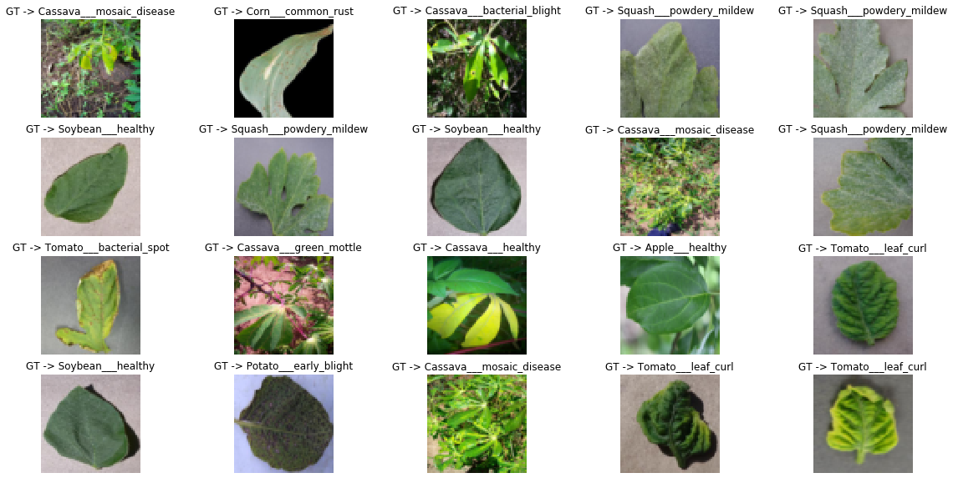
Dataset

Slide 22
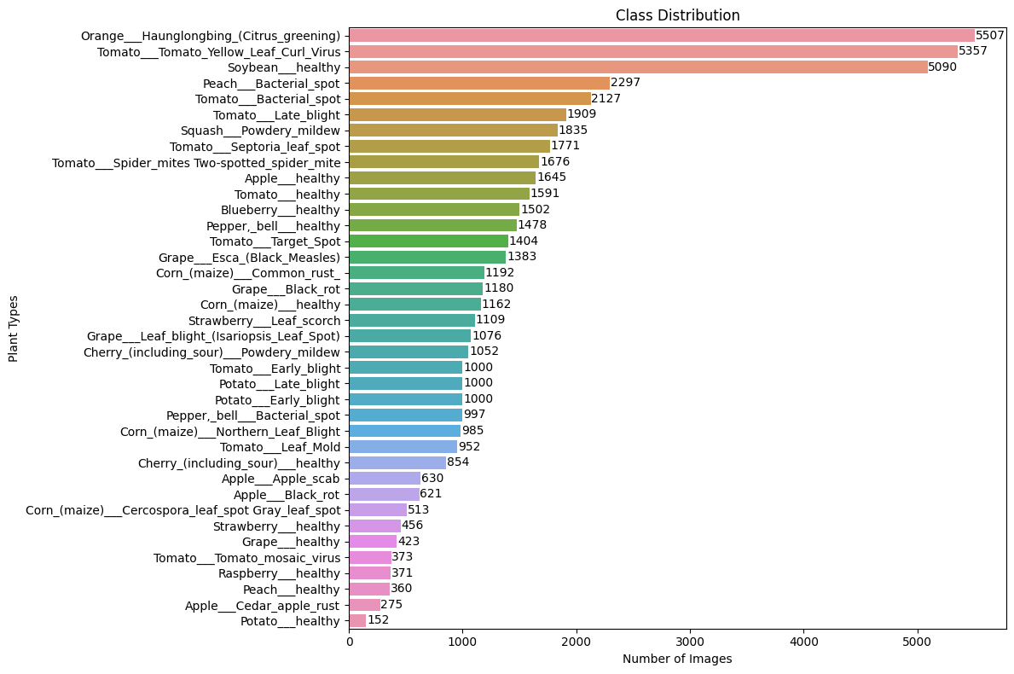
Data Class distribution:

Slide 23
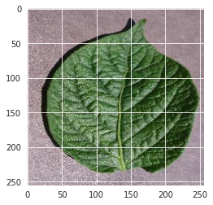
Data Augmentation:
Training dataset: 70% of the images from over 50,000 expertly curated images on healthy and infected leaves of crop plants, available on the PlantVillage platform.
Testing dataset: 30% of the images, also sourced from the PlantVillage platform.
Standardization: Resizing all images to 100x100 pixels to ensure uniformity across the dataset.
Transformation: Gray scaling all images to simplify the data and remove color variation, aiding in the efficiency of machine learning algorithms.

Slide 24
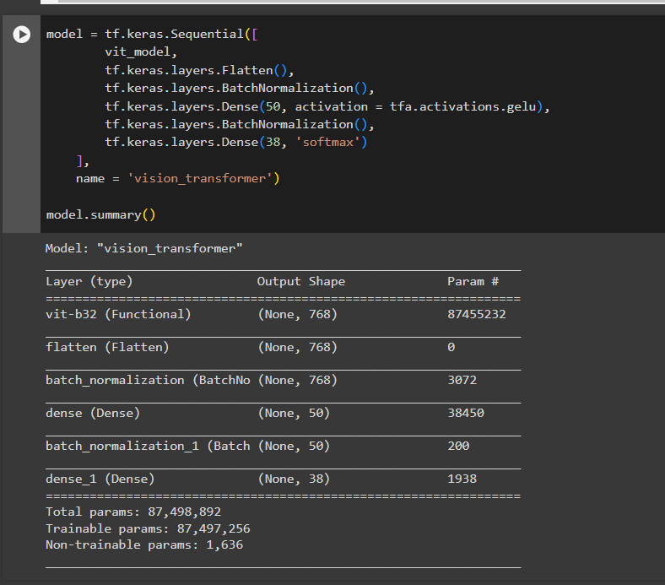
Model Architecture :

Slide 25
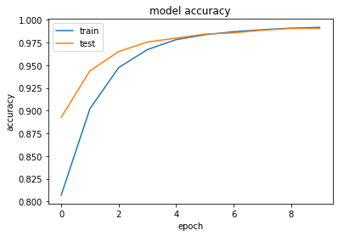
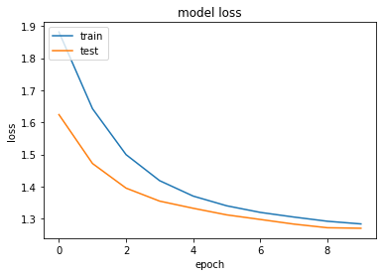
Model Accuracy and losses graph :
Training accuracy: 98.2%
Validation Accuracy: 96.8%

Slide 26
Diagrams

Slide 27
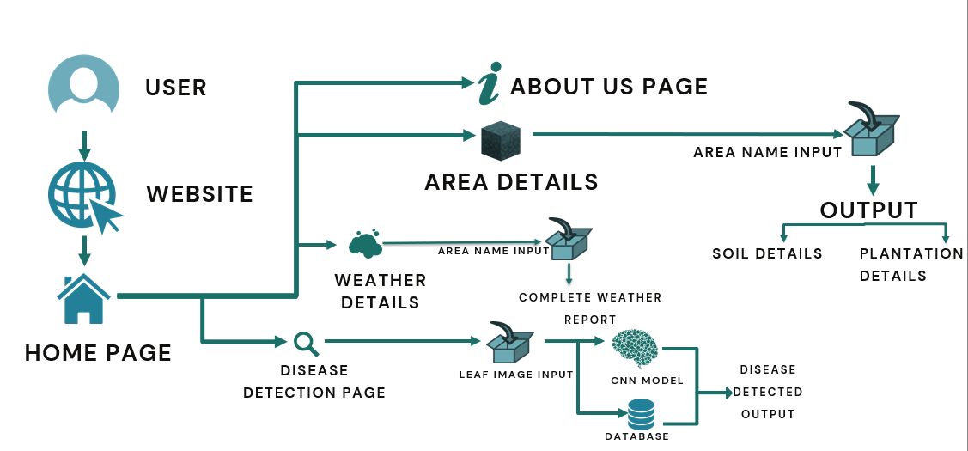
CONCEPTUAL DIAGRAM

Slide 28
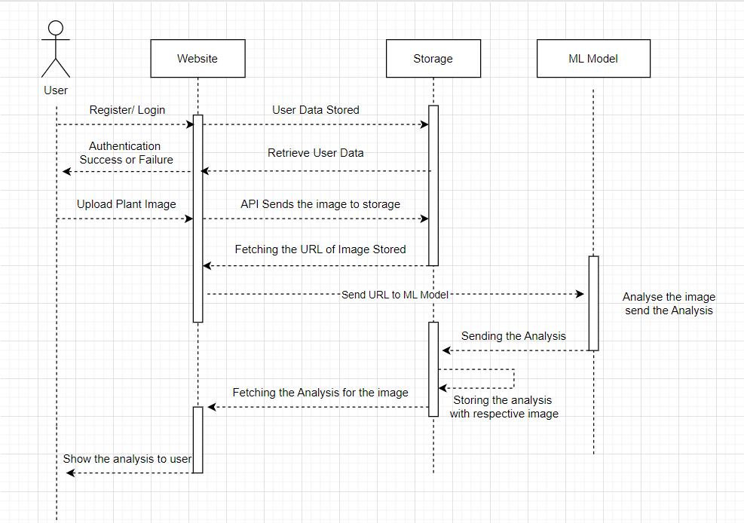
SEQUENCE DIAGRAM

Slide 29
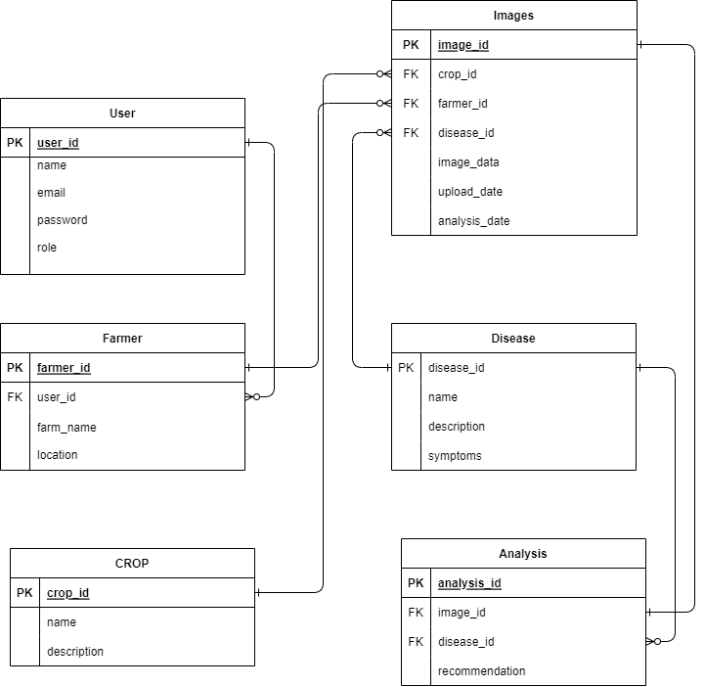
Class Diagram

Slide 30
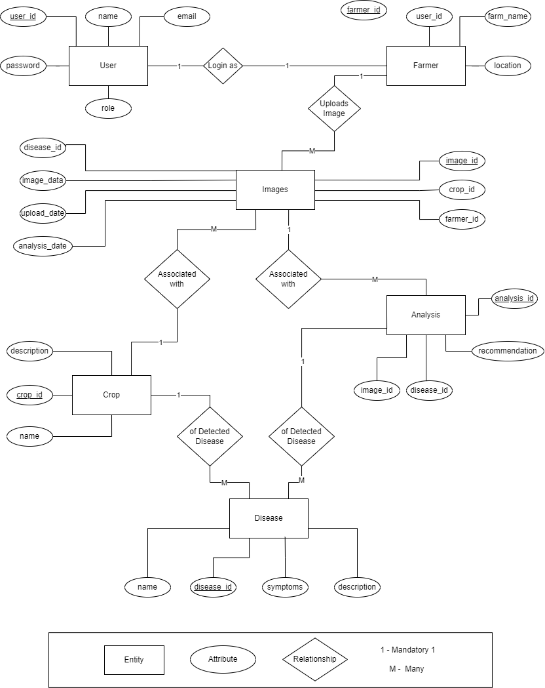
ER Diagram

Slide 31
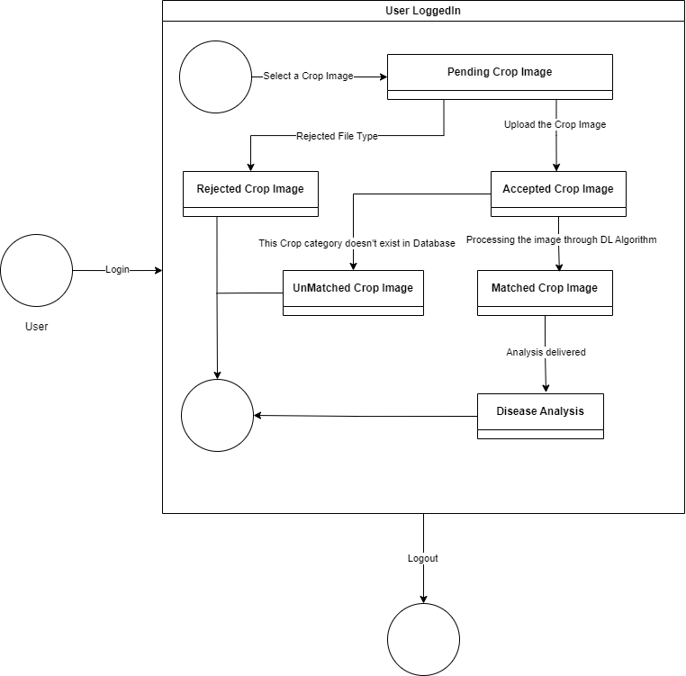
State Diagram

Slide 32
Sprint -2 Recap
Designed the front end for the MVP.
Image upload for uploading the plant image for detection.
Weather forecast page with the select area and the output showing the weather in that area.
Area page with details about that area’s soil, crops etc.
Diagrams such as architecture, conceptual and sequence diagrams.
Home page and about us page
Retrospective
User Stories/ Acceptance criteria
Application test cases
Demo

Slide 33
PRODUCT BACKLOG

Slide 34
Project Backlog
Database
CSS Formatting
Login Page Authentication
Backend connection
API Connection
Weather Information / webpage
Weather information / API
Retrieval efficiency from Database
Model Accuracy
Deliverable 3
Wiki page update

Slide 35
All the Users Stories or Tasks (Technical Stories)
Estimation | ID | User Story | Status | Place/Feature
3 | PD-01 | I want to upload an image of a plant leaf to detect diseases. | Done | Disease Detection
3 | PD-02 | I want to receive detailed information about the detected plant disease. | Done | Disease Detection
4 | PD-03 | I want to view prescriptions and suggested supplements for the detected disease. | Done | Disease Detection
6 | PD-04 | I want to know the various cures and preventive measures for the detected disease. | Done | Disease Detection
5 | PD-05 | I want to see the stages of the detected disease for better understanding. | Done | Disease Detection
9 | PD-06 | I want to verify if the image is right | Done | User Interface
10 | PD-07 | Send prompt to user if the image is not in correct format | Done | User Interface

Slide 36
Estimation | ID | User Story | Status | Place/Feature
6 | PD-08 | I want to know if this crop is available in database | Done | Database
6 | PD-09 | I want information about suitable crops and growth conditions for my area. | To be done | Agriculture Details
5 | PD-10 | I want to see the latest news related to agriculture and farming practices. | To be done | Agriculture News
4 | PD-11 | I want to receive notifications or updates about my uploaded plant reports. | To be done | Notification System
5 | PD-12 | I want to explore and learn about new farming technologies and practices. | To be done | Agriculture Information
2 | PD-13 | I want to create account on the website so that I can keep my account private and login using email/phone and password | To be done | Login and Authentication
2 | PD-14 | I want to login to the website to store my information. | To be done | Login
3 | PD-15 | I want to logout so that my information and reports are secure. | To be done | Logout

Slide 37
User Stories / Acceptance Criteria
User ID | Scenario | Summary | Criteria | Feature
1 | I want to upload an image of a plant leaf to detect diseases.
 | A user wants to upload an leaf image | when I go to the EcoScan website, I should be able to find an upload button. When I click on it and choose an image, the app should save the picture so that it can be processed. | EcoScan website will store the image for processing | Disease Detection
2 | I want to receive detailed information about the detected plant disease.
 | A user wants to know the detailed information | Given I am a, user when I upload the image I should be able to get detailed information about the disease detected | EcoScan website will store the information about the disease. | Disease Detection
3 | I want to view prescriptions and suggested supplements for the detected disease.
 | A user wants to view prescriptions and supplements. | I want to view the prescriptions and supplements suggested for the disease being detected. | EcoScan website will store the information about the disease. | Disease Detection

Slide 38
User ID | Scenario | Summary | Criteria | Feature
4 | I want to know the various cures and preventive measures for the detected disease.
 | A user wants to know preventive measures. | Given that I am a user, I want to know the steps to be taken to cure and prevent detected disease. | EcoScan website will provide diagnosis for the disease. | Disease Detection
5 | I want to see the stages of the detected disease for better understanding.
 | A user wants to look at the disease stages being detected. | I want to about all the stages detected for the particular disease. | EcoScan website will provide diagnosis for the disease. | Disease Detection
6 | A user want to check if image uploaded is in right format.
 | A user wants to check weather condition. | I want to know if the image being uploaded is in right format | EcoScan website will check the image and its formatUser Interface | User Interface

Slide 39
User ID | Scenario | Summary | Criteria | Feature
7 | Send prompt to user if the image is not in correct format
 | A user wants know if the image uploaded is correct or not. | Given that I am a user, I want to receive the prompt/notification knowing if the image format is correct or no. | EcoScan website will check the image and its format | User Interface
8 | A user want to know about image of the crop selected is available in the dataset.
 | A user wants to check crop type exist or not. | I want to know if the crop I have selected is available in the dataset. | EcoScan website will check if particular crop is present in datasetAgriculture Information | Image Checking in Database
9 | I want information about suitable crops and growth conditions for my area.
 | A user wants to know about growth conditions for his area | I want to know which crop will be suitable for my area and how its growth will be. | EcoScan website will give information on crop suitability. | Agriculture Information

Slide 40
User ID | Scenario | Summary | Criteria | Feature
10 | I want to see the latest news related to agriculture and farming practices.
 | A user wants latest news related to agriculture. | I want to know about the latest news that are related to agriculture and farming. | EcoScan website will provide latest news based on agriculture.
11 | I want to receive notifications or updates about my uploaded plant reports.
 | A user wants to receive notification about his plants. | Given that I am user, I want to get notified about the reports of my plant being uploaded. | EcoScan website will send notifications related to uploads. | Notification System
12 | I want to explore and learn about new farming technologies and practices.
 | A user want to explore and learn about farming. | I want to know and explore about new farming techniques and practices. | EcoScan website gives information on farming techniques. | Agriculture Information

Slide 41
User ID | Scenario | Summary | Criteria | Feature
13 | I want to create an account on the website so that I can keep my account private and login using email/phone and password
 | A user wants to create an account and login using his details. | I want to create an account and keep my account private with my login credentials. | EcoScan website will be able to create login credentials. | Home Page
14 | I want to login to the website to store any information.
 | A user wants to login to the website to store the information. | I want to login to the website using my login details to store any information. | EcoScan website will log you in and store the information given. | Log In
15 | I want to logout so that my information and reports are secure.
 | A user want to logout and secure the information. | I want to logout from my account to secure my information. | EcoScan website will log you out by securing your information. | Log Out

Slide 42
Sprint 3 BACKLOG

Slide 43
Sprint 3 Backlog
Estimation | ID | User Story | Status
9 | PD-06 | I want to check the current weather conditions in my area. | To be done
10 | PD-07 | I want to view detailed weather reports and forecasts for agriculture planning. | To be done
6 | PD-08 | I want to check soil type and recommended plantations for my geographical area. | To be done
6 | PD-09 | I want information about suitable crops and growth conditions for my area. | To be done
5 | PD-10 | I want to see the latest news related to agriculture and farming practices. | To be done
4 | PD-11 | I want to receive notifications or updates about my uploaded plant reports. | To be done
5 | PD-12 | I want to explore and learn about new farming technologies and practices. | To be done

Slide 44
Test Cases
Functionality to Test | Test Case Scenarios | Expected Results | Actual Results | Pass/Fail
Image Upload Functionality | User uploads a valid image of a plant leaf. | The system should identify the disease, display prevention supplements, stage, and details. | The system correctly identifies the disease, displays relevant information, and provides details. | Pass
 | User uploads an invalid image format. | The system should prompt an error message indicating the unsupported format. | The system correctly handles the invalid format and prompts the user with an appropriate message. | Pass
 | User uploads an image that is not a plant leaf. | The system should prompt an error message indicating that the uploaded image is not valid. | The system correctly identifies the invalid content and provides a relevant error message. | Pass
Area Report Functionality | User requests a report for a specific area. | The system should display information on diseases, soil type, and plantation details for the area. | User is unable to request a report for an invalid or non-existent area. | Fail
 | User requests a report for an invalid or non-existent area. | The system should prompt an error message indicating that the area is not found. | The system didn't prompt an error message indicating that the area is not found. | Fail
Soil Type and Plantation Details | User selects an area to view soil type and plantation details. | The system should display accurate information about the soil type and plantation in that area. | The system didn't display accurate information about the soil type and plantation in that area. | Fail
 | User selects an area with no available data. | The system should inform the user that no data is available for the selected area. | The system didn't inform the user that no data is available for the selected area. | Fail

Slide 45
Functionality to Test | Test Case Scenarios | Expected Results | Actual Results | Pass/Fail
User Interface and Navigation | User navigates through the website without uploading an image. | The system should provide a user-friendly interface with clear navigation options. | The system didn'tprovide a user-friendly interface with clear navigation options. | Fail
 | User attempts to access restricted areas without proper authentication. | The system should prompt the user to log in before accessing restricted areas. | The system didn'tprompt the user to log in before accessing restricted areas. | Fail
Prevention Supplements Information | User views prevention supplements for a specific disease. | The system should display accurate information on prevention supplements for the disease. | The system displayed accurate information on prevention supplements for the disease. | Pass
 | User views prevention supplements for a disease with no available data. | The system should inform the user that no data is available for prevention supplements. | The system informed the user that no data is available for prevention supplements. | Pass
Disease Stage Information | User checks the stage of a detected disease. | The system should show the current stage of the detected disease. | The system accurately displays the current stage of the detected disease. | Pass
 | User checks the stage of a healthy plant (no disease detected). | The system should indicate that the plant is healthy and not in any disease stage. | The system correctly identifies and communicates that the plant is healthy with no disease stage. | Pass
Area Report with Historical Data | User requests a historical report for a specific area. | The system should provide historical data on diseases, soil type, and plantation details. | The system didn't provide historical data on diseases, soil type, and plantation details. | Fail
 | User requests a historical report for an area with no historical data. | The system should inform the user that no historical data is available for the area. | The system didn'tinform the user that no historical data is available for the area. | Fail

Slide 46
Functionality to Test | Test Case Scenarios | Expected Results | Actual Results | Pass/Fail
User Profile and Preferences | User updates their profile information. | The system should reflect the updated user profile information. | The system couldn't reflect the updated user profile information. | Fail
 | User sets preferences for notification alerts. | The system should send notification alerts based on the user's preferences. | The system couldn't send notification alerts based on the user's preferences. | Fail
Feedback and Support | User submits feedback through the website. | The system should receive the feedback and store it for analysis. | The system couldn't receive the feedback and store it for analysis. | Fail
 | User accesses the support section for assistance. | The system should provide relevant support information and contact details. | The system couldn't provide relevant support information and contact details. | Fail

Slide 47
Stories Completed
Story Points | ID | User Story | Status
2 | PD-01 | I want to upload an image of a plant leaf to detect diseases. | Done
4 | PD-02 | I want to receive detailed information about the detected plant disease. | Done
4 | PD-03 | I want to view prescriptions and suggested supplements for the detected disease. | Done
3 | PD-04 | I want to know the various cures and preventive measures for the detected disease. | Done
3 | PD-05 | I want to see the stages of the detected disease for better understanding. | Done
2 | PD-06 | I want to verify if the image is right | Done
2 | PD-07 | Send prompt to user if the image is not in correct format | Done
2 | PD-08 | I want to know if this crop is available in database | Done

Slide 48
Metrices

Slide 49
Team Velocity – this sprint
22 Story Points

Slide 50
Team’s Historical Average

Slide 51
Completed Ratio
completed/committed ratio = 22/22, which is 100%

Slide 52
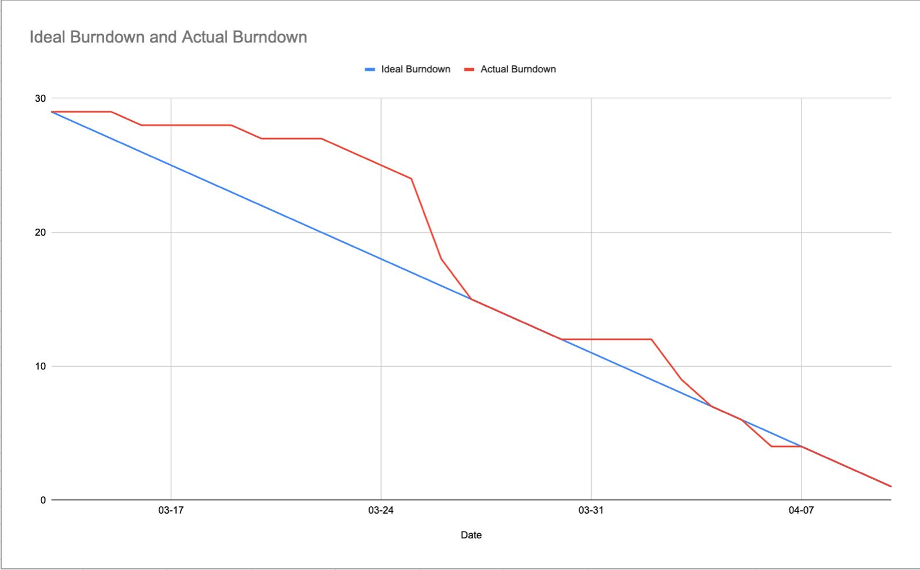
Burn down chart – Sprint 3

Slide 53
RETROSPECTIVE

Slide 54
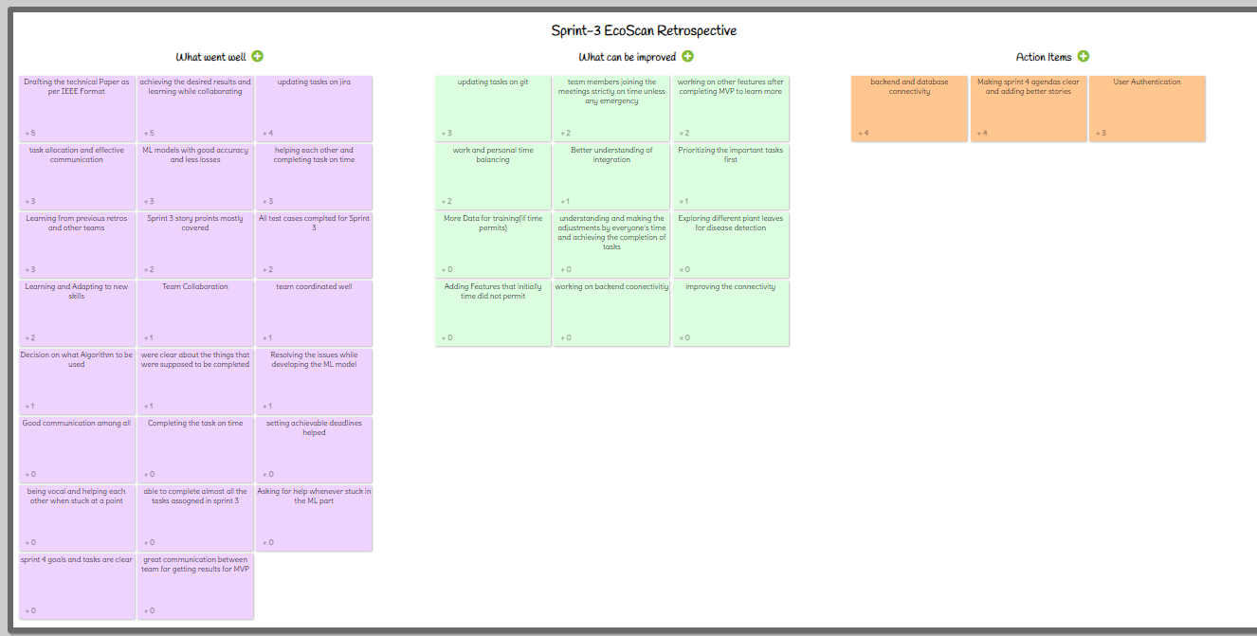
IDEA BOARD

Slide 55
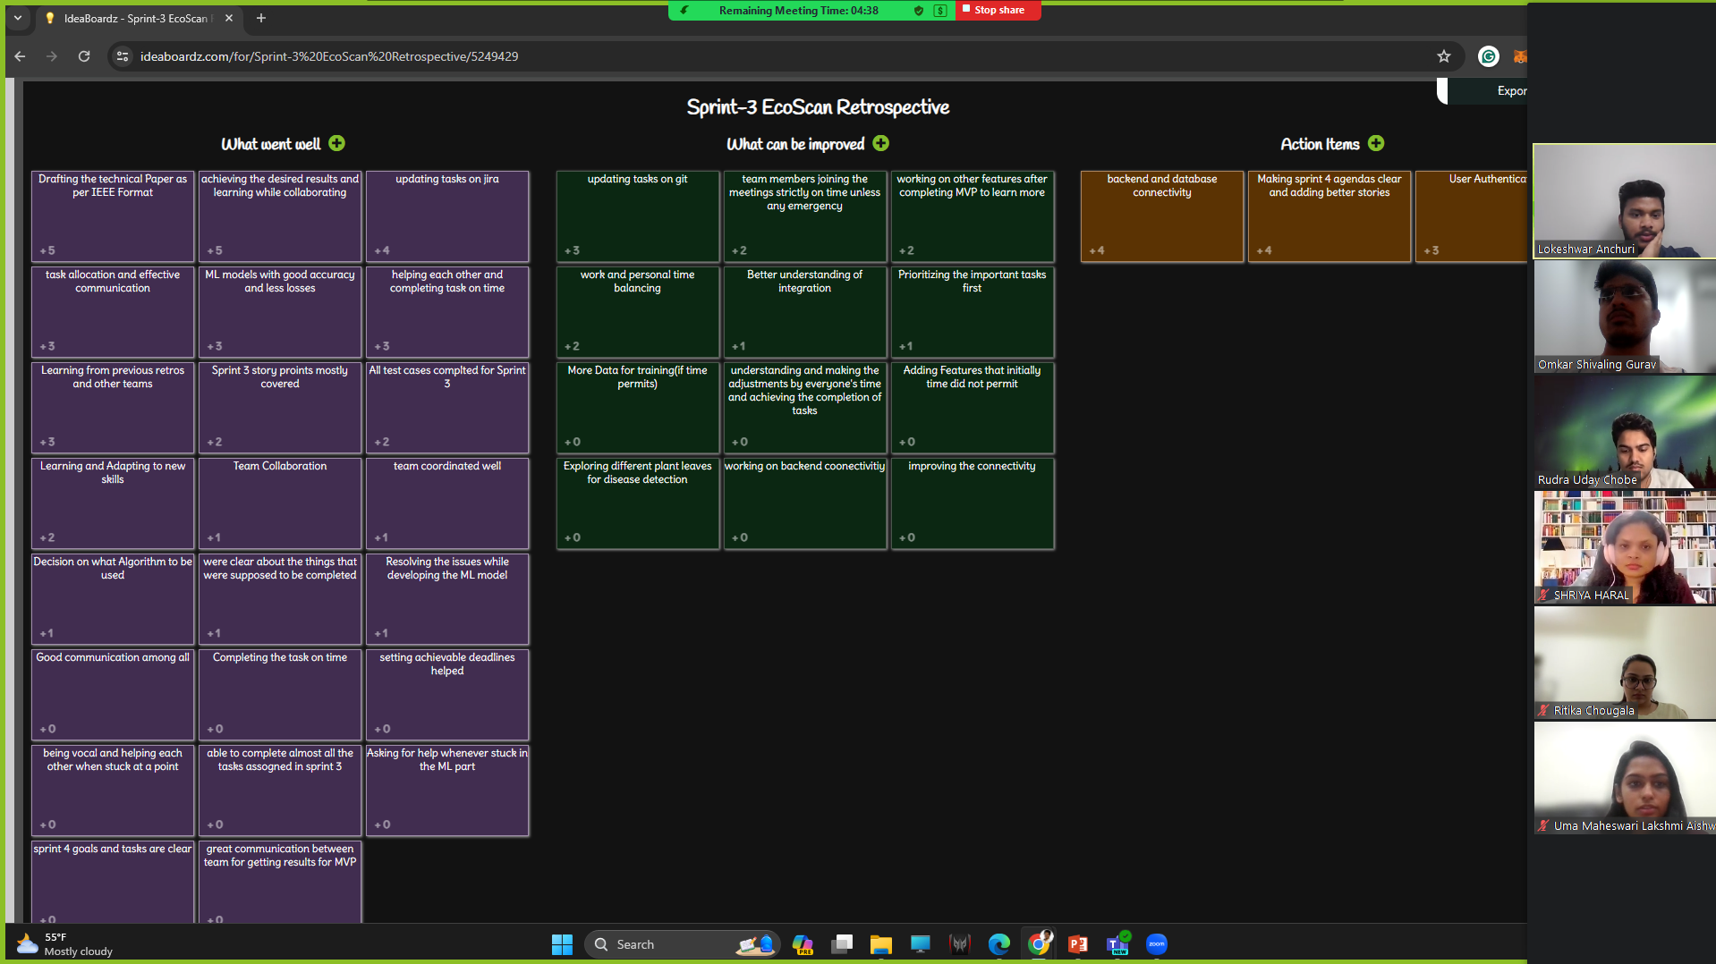

Slide 56

What went well?
Drafting of the technical paper as per IEEE format.
Achieving the desired results and learning with collaboration.
Updating the tasks on JIRA.
Task allocation and effective communication.
ML models with good accuracy and less losses.

Slide 57
What can be improved?
Updating the tasks on Git.
Team members joining the meetings strictly on time unless any
Emergency.
Working on other features after completing the MVP to learn more.
Work and personal time balancing.

Slide 58
Action Items?
Backend and database connectivity.
Making sprint -4 agenda clear and adding better stories
User authentication.

Slide 59
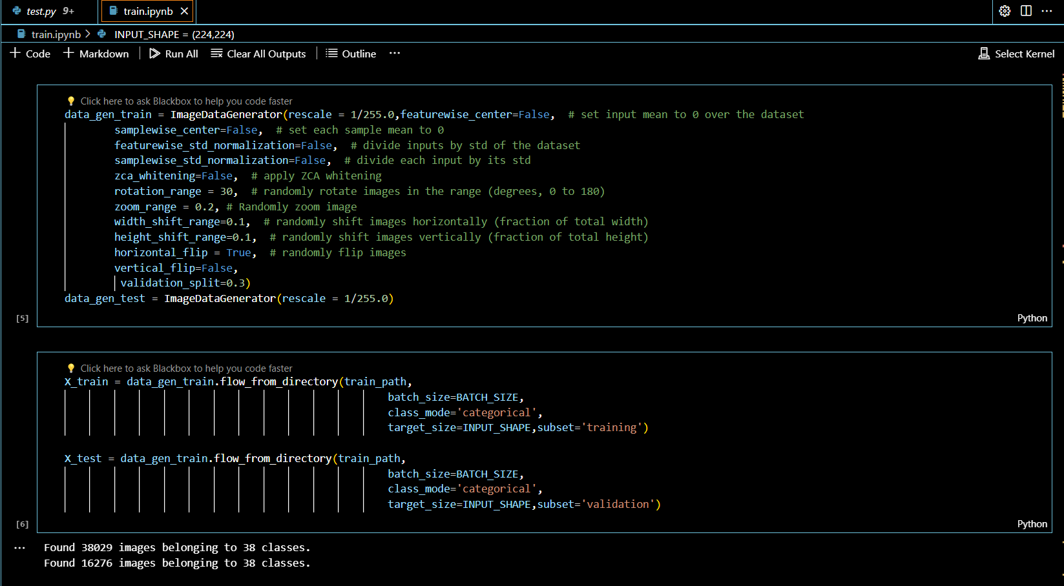
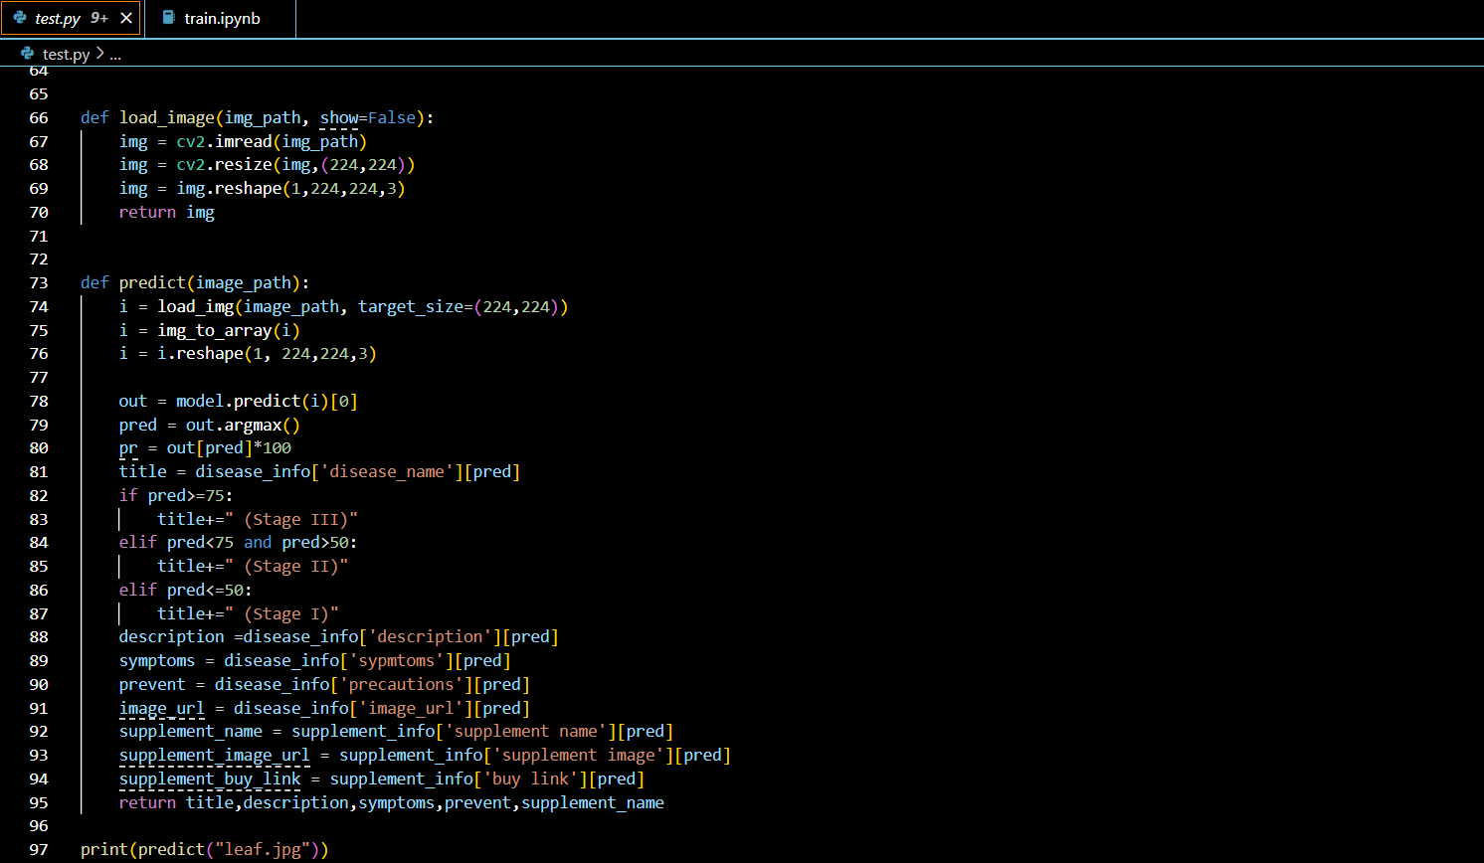
CODE SNIPPET
Training code
Testing code

Slide 60
PLAN FOR SPRINT 4

Slide 61
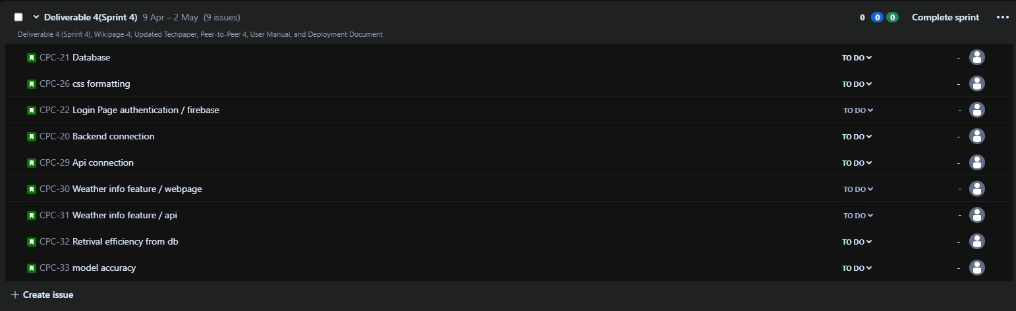
PLAN FOR SPRINT 4

Slide 62
PROJECT DEMO

Slide 63
Show live demo
Live Demo is available on our Wiki Page

Slide 64
App screenshots

Slide 65
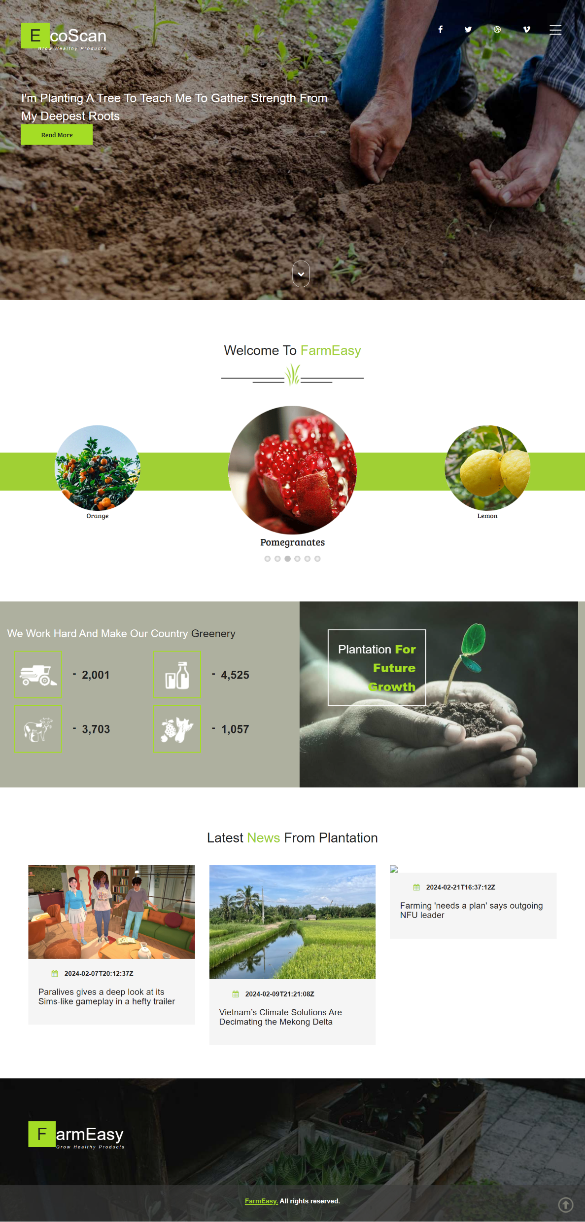
APPLICATION SCREENSHOT
HOMEPAGE
- A welcoming header that introduces the user to the application, setting a positive and inviting tone.
- A section featuring the latest news related to agriculture, keeping users informed about relevant updates and developments.
- Various buttons strategically placed to redirect users to different pages within the application, providing easy access to specific features or sections.
- Conveniently placed links or buttons that swiftly redirect users to the application's social media platforms.
- A dedicated section showcasing statistics related to the application.
HOMEPAGE

Slide 66
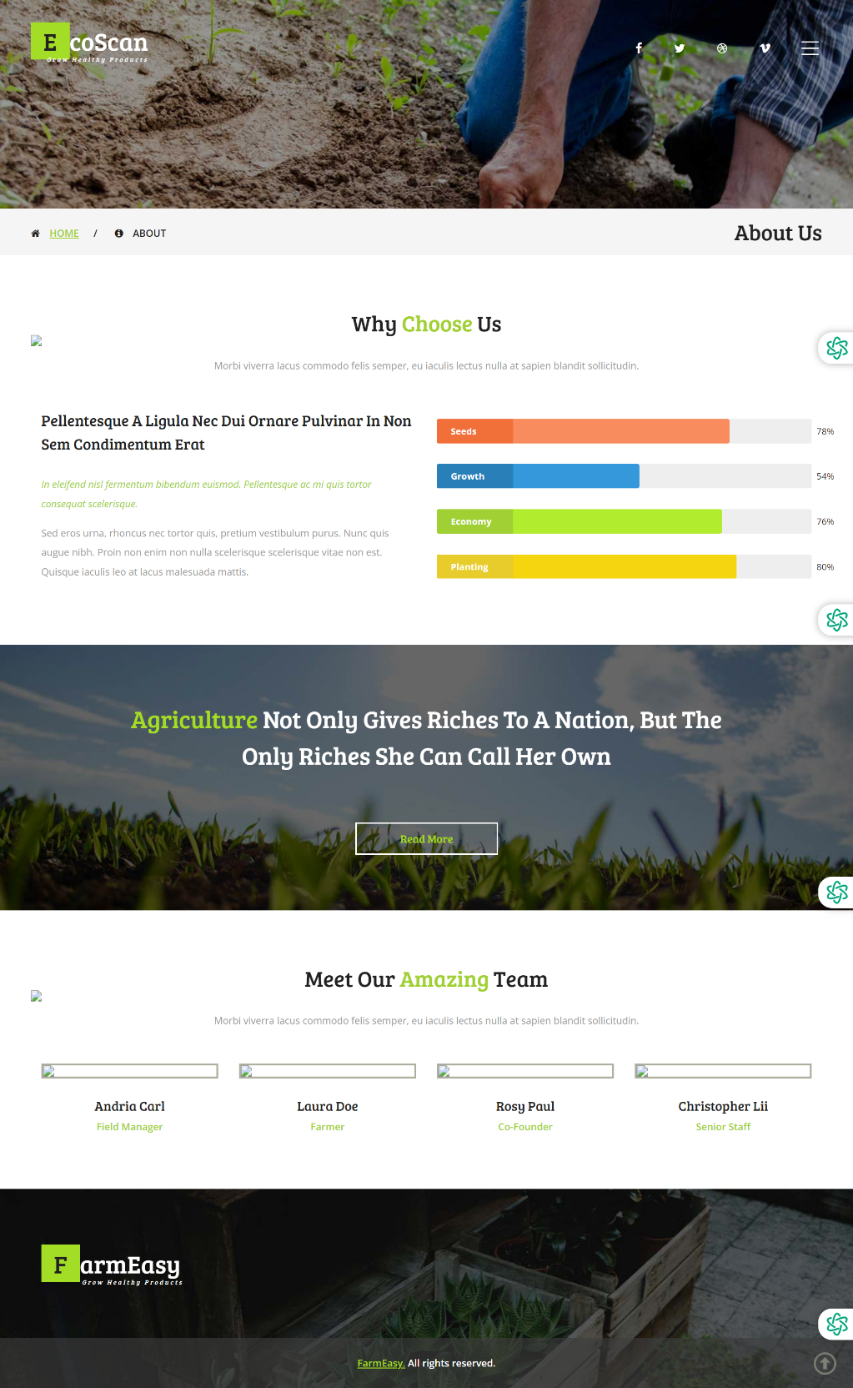
APPLICATION SCREENSHOT
ABOUT US PAGE
- A friendly and inviting introduction at the top of the page, creating a positive tone and making users feel welcomed upon entering the application.
- Clearly labeled tabs, such as 'Home,' 'Area Details,' 'About Us,' etc., facilitating easy navigation and ensuring users can quickly access specific sections of the application.
- A dedicated portion of the page explaining the reasons for users to choose the application. This section likely highlights the unique features, benefits, or values that set the application apart.
- Information about the application's team, providing users with insights into the individuals behind the scenes. This personal touch can enhance trust and connection.
ABOUT US

Slide 67
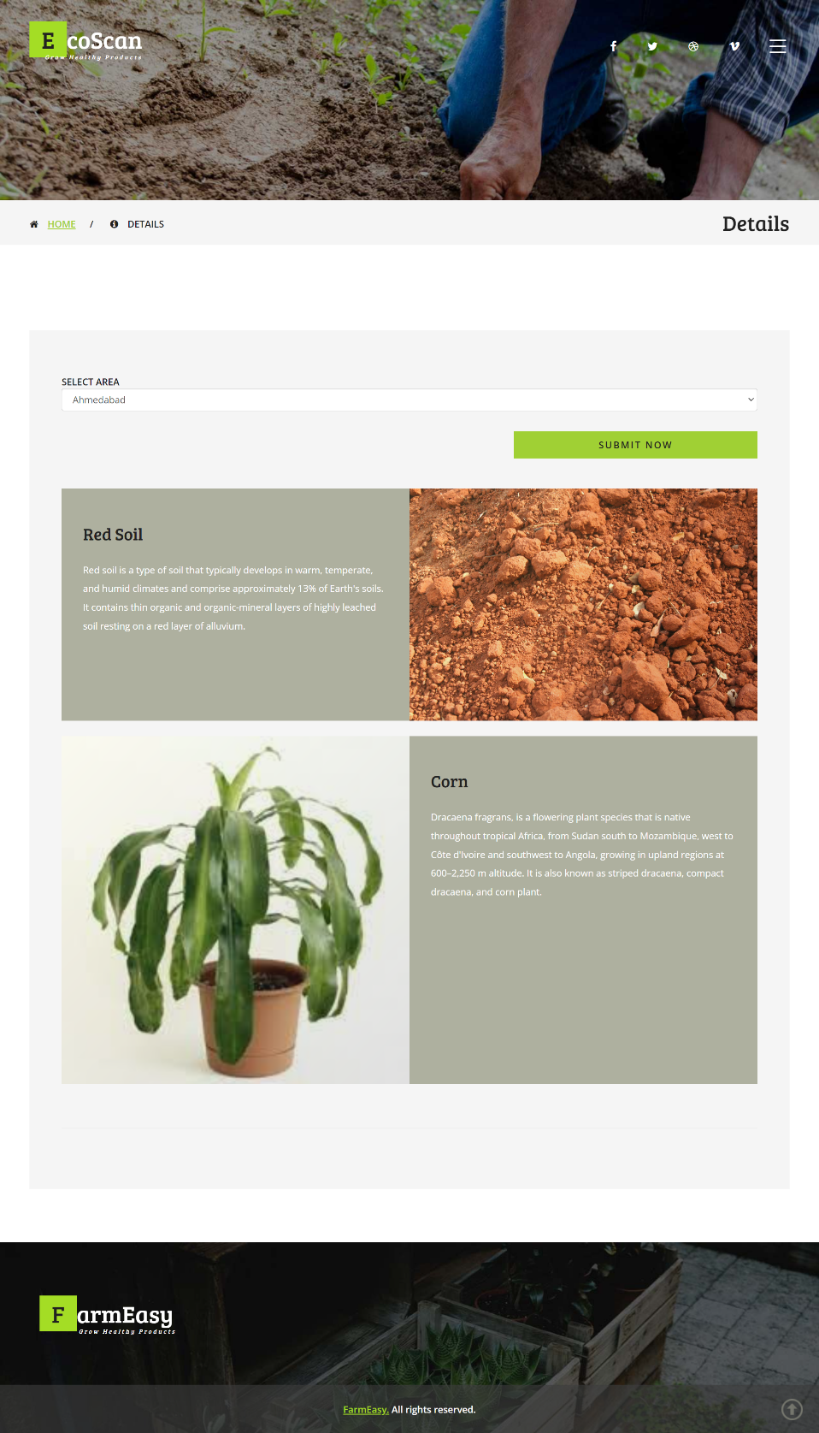
APPLICATION SCREENSHOT
AREA DETAILS
- User-friendly interface allowing users to select their desired area, enhancing customization and providing relevant information based on geographical preferences.
- Detailed information on the soil types in the selected area, aiding users in understanding the soil composition and its suitability for different types of plantations.
- A section suggesting suitable plantations for the chosen area, helping users make informed decisions about what crops or plants thrive in the specific soil conditions of their selected region.
Area Details

Slide 68
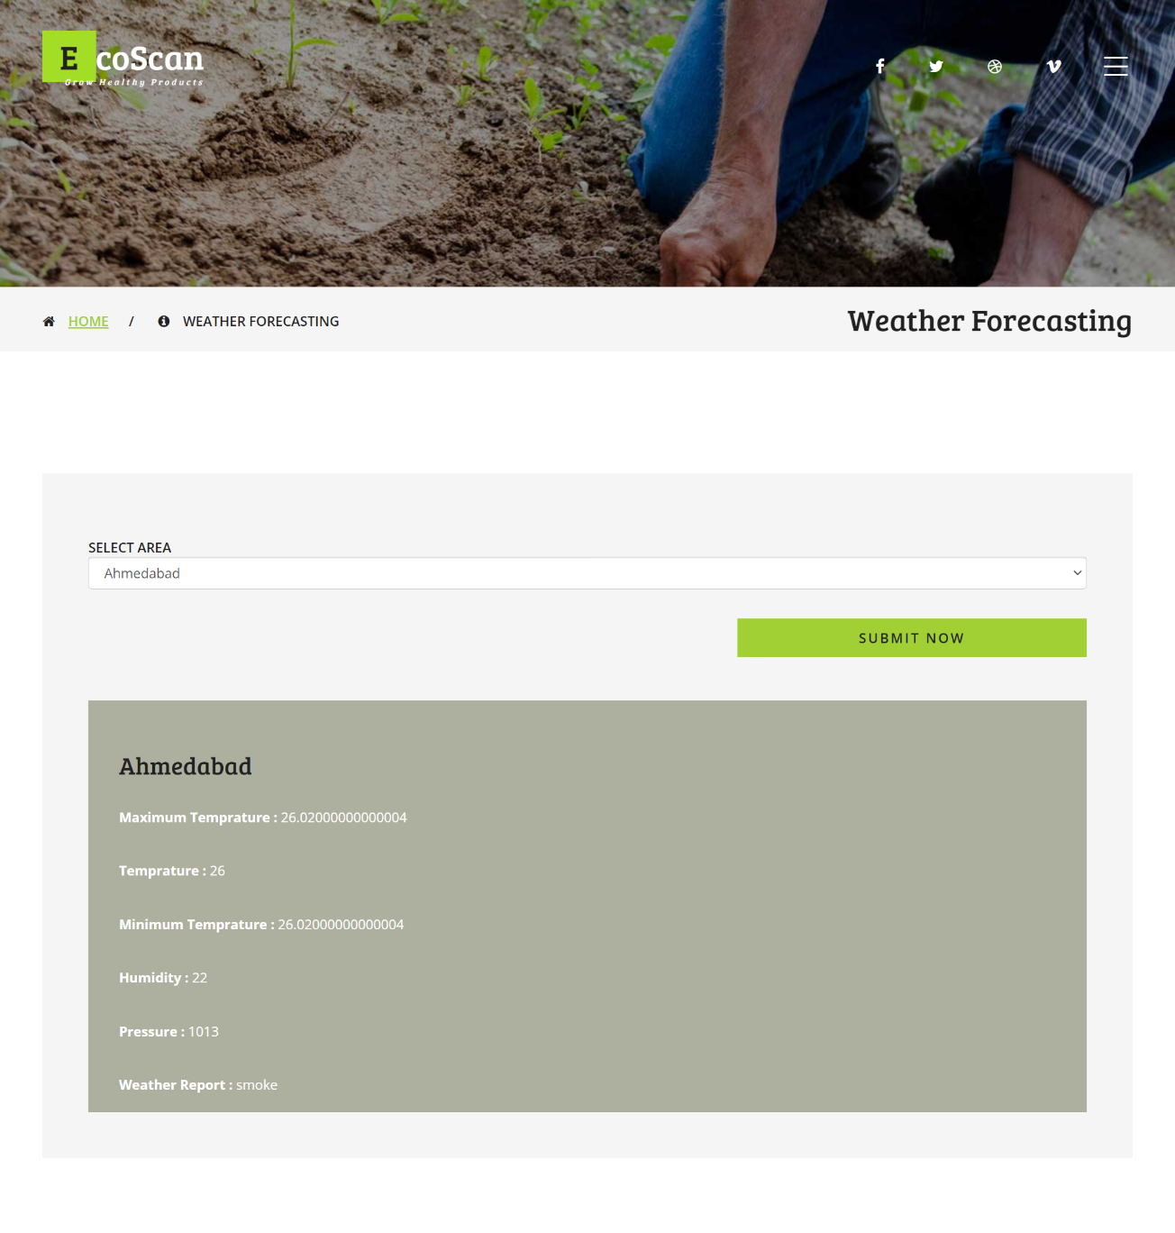
APPLICATION SCREENSHOT
WEATHER FORECAST PAGE
- An interactive feature allowing users to choose a specific area for which they want to check the weather forecast, providing localized and relevant information.
- A visually appealing and user-friendly layout that facilitates easy comprehension of weather data, enhancing the overall user experience.
- The ability to refresh or update the weather information in real-time, keeping users informed with the latest and most accurate forecasts.
- Design considerations to ensure the weather forecast page is accessible and user-friendly across various devices, including desktops, tablets, and cell phones.
Weather Details

Slide 69
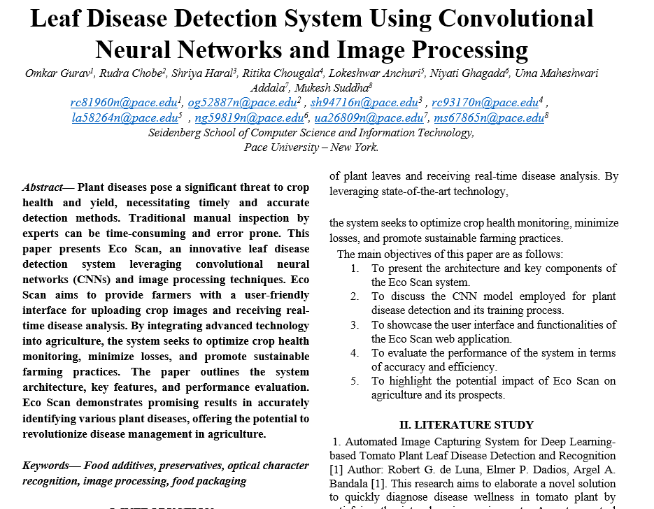
Technical Paper

Slide 70
Wiki Page Link
https://github.com/htmw/2024S-AlgoAvengers

Slide 71


THANK YOU

